Slide 1
Compression rate adaptation based on RTP video stream and full utilization of network data packets
YUCHENG JING SANG-CHUL KIM
jingyucheng@kookmin.ac.kr sckim@kookmin.ac.kr
Kookmin University

Slide 2
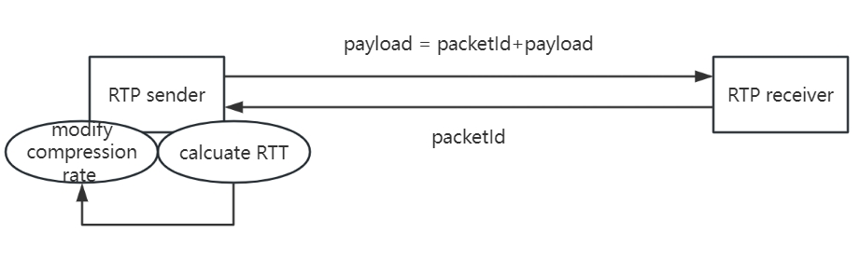
Compression rate adaptation based on RTP video stream
The traditional RTP protocol is a one-way transmission. The sending end is only responsible for sending, and the receiving end is only responsible for receiving. However, when the network environment undergoes other changes such as congestion, serious losses will be caused at the receiving end due to reduced quality of service (QoS). Packets loss cause a reduction in transmission quality, which will seriously affect the user experience.
Therefore, we design a video compression rate adaptive algorithm to adjust the video compression rate in real time based on network conditions and bandwidth availability.
Our work:
After the sender sends the data, it will record the number of each data packet.(as the picture)
When the sender receives the returned packet number, it will record the round-trip time (RTT) based on the time of sending.
Evaluate the current network status based on RTT and adjust the compression rate of the next video

Slide 3
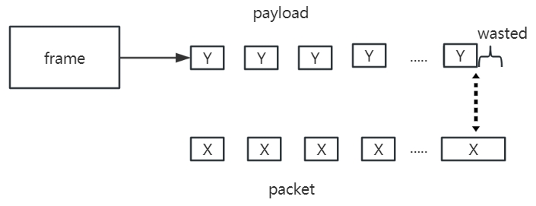
full utilization of network data packets
Since each RTP packet has a maximum size limit, data segmentation is particularly important. Unreasonable packet segmentation will cause a waste of network resources.We assume that the optimal packet size in the RTP protocol is XThen during the video transmission process, we cannot guarantee that the size Y of each frame after video compression can be evenly divided by X, so Y % X is an underutilized network resource (data packet).And as the number of video transmission frames increases, wasted network resources also gradually increase.
Therefore, we designed a data packet filling algorithm. This algorithm can temporarily store the data when the transmitted data size is less than the size of a data packet, and place this data before the next frame of data, together with the next frame. The data are packaged and transmitted together, so that network resources can be fully utilized, and at the receiving end, the data of the two frames are divided according to the segmentation feature "\xff\xd9" of the JPEG image to restore the original frame data.

Slide 4
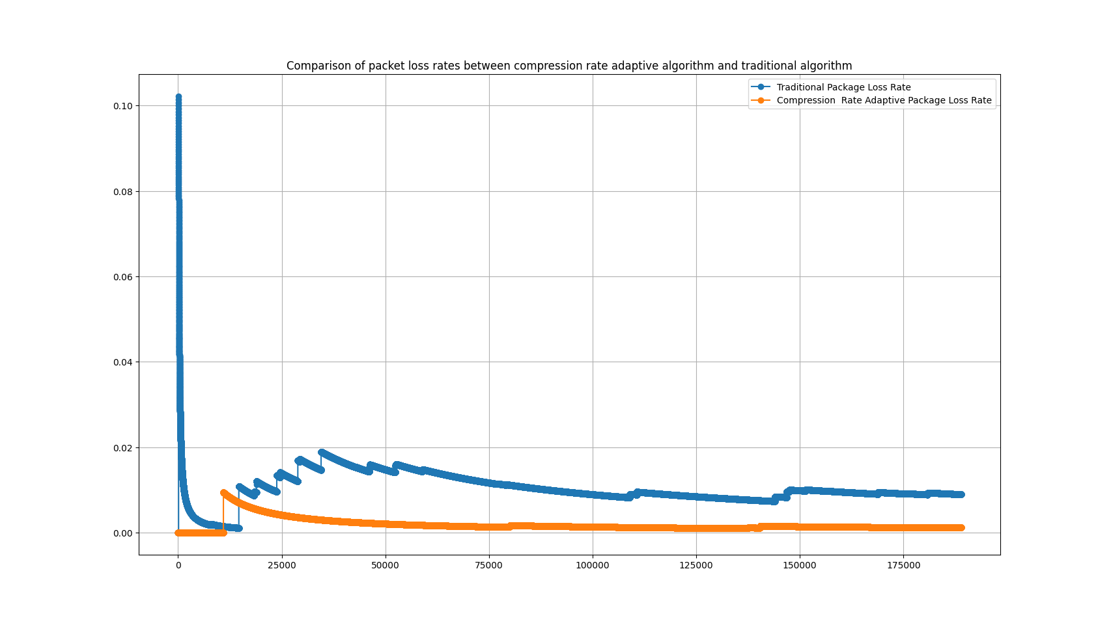
Results
We use a network that is transmitting very large files to simulate a network environment under greater pressure.
After testing and using the dynamic adaptive compression rate algorithm, the packet loss rate has been significantly reduced.
In the figure, the abscissa represents the total number of data packets, and the ordinate represents the loss. Packet rate.
And the video resolution played at the receiving end is also automatically adjusted, and the frequency of abnormal phenomena such as screen tearing and flickering has also been significantly reduced.

Slide 5
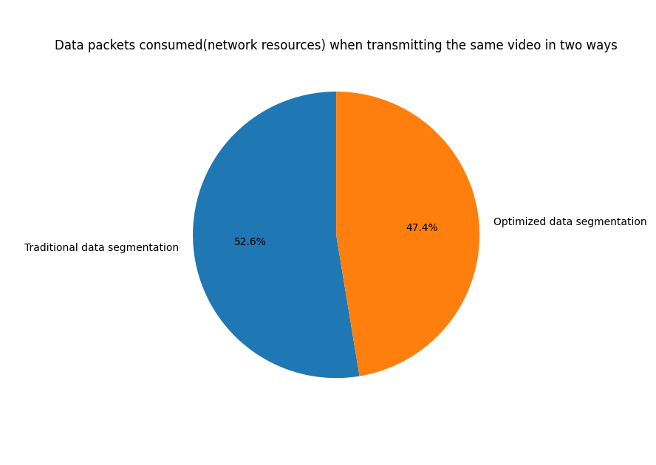
Results
In terms of packet segmentation, we use the optimized packet segmentation algorithm and the traditional segmentation algorithm to completely transmit the same video and compare them at the receiving end.
In the best network environment (no packet loss), the total amount of data packets received by the receiving end after optimization of data packet segmentation is less than the total amount of data packets consumed under the traditional data packet segmentation method.
The video used in our experiment consumes 202,488 data packets in the traditional segmentation method. The number of data packets consumed after the optimized data packet segmentation is 192,294, saving 10,194 data packets and improving the rate. about 5%

Slide 6

Thank you

